Slide 1
GOOGLE SLIDES
GROUP 4
Members:
Abdullah
Cubio
Mandalunes
Meniano
Montaña
Narisma
Opao
Pespeñan
Reyes

Slide 2
INTERACTIVE ACTIVITY
RED LIGHT: GOOGLE SLIDES

Slide 4

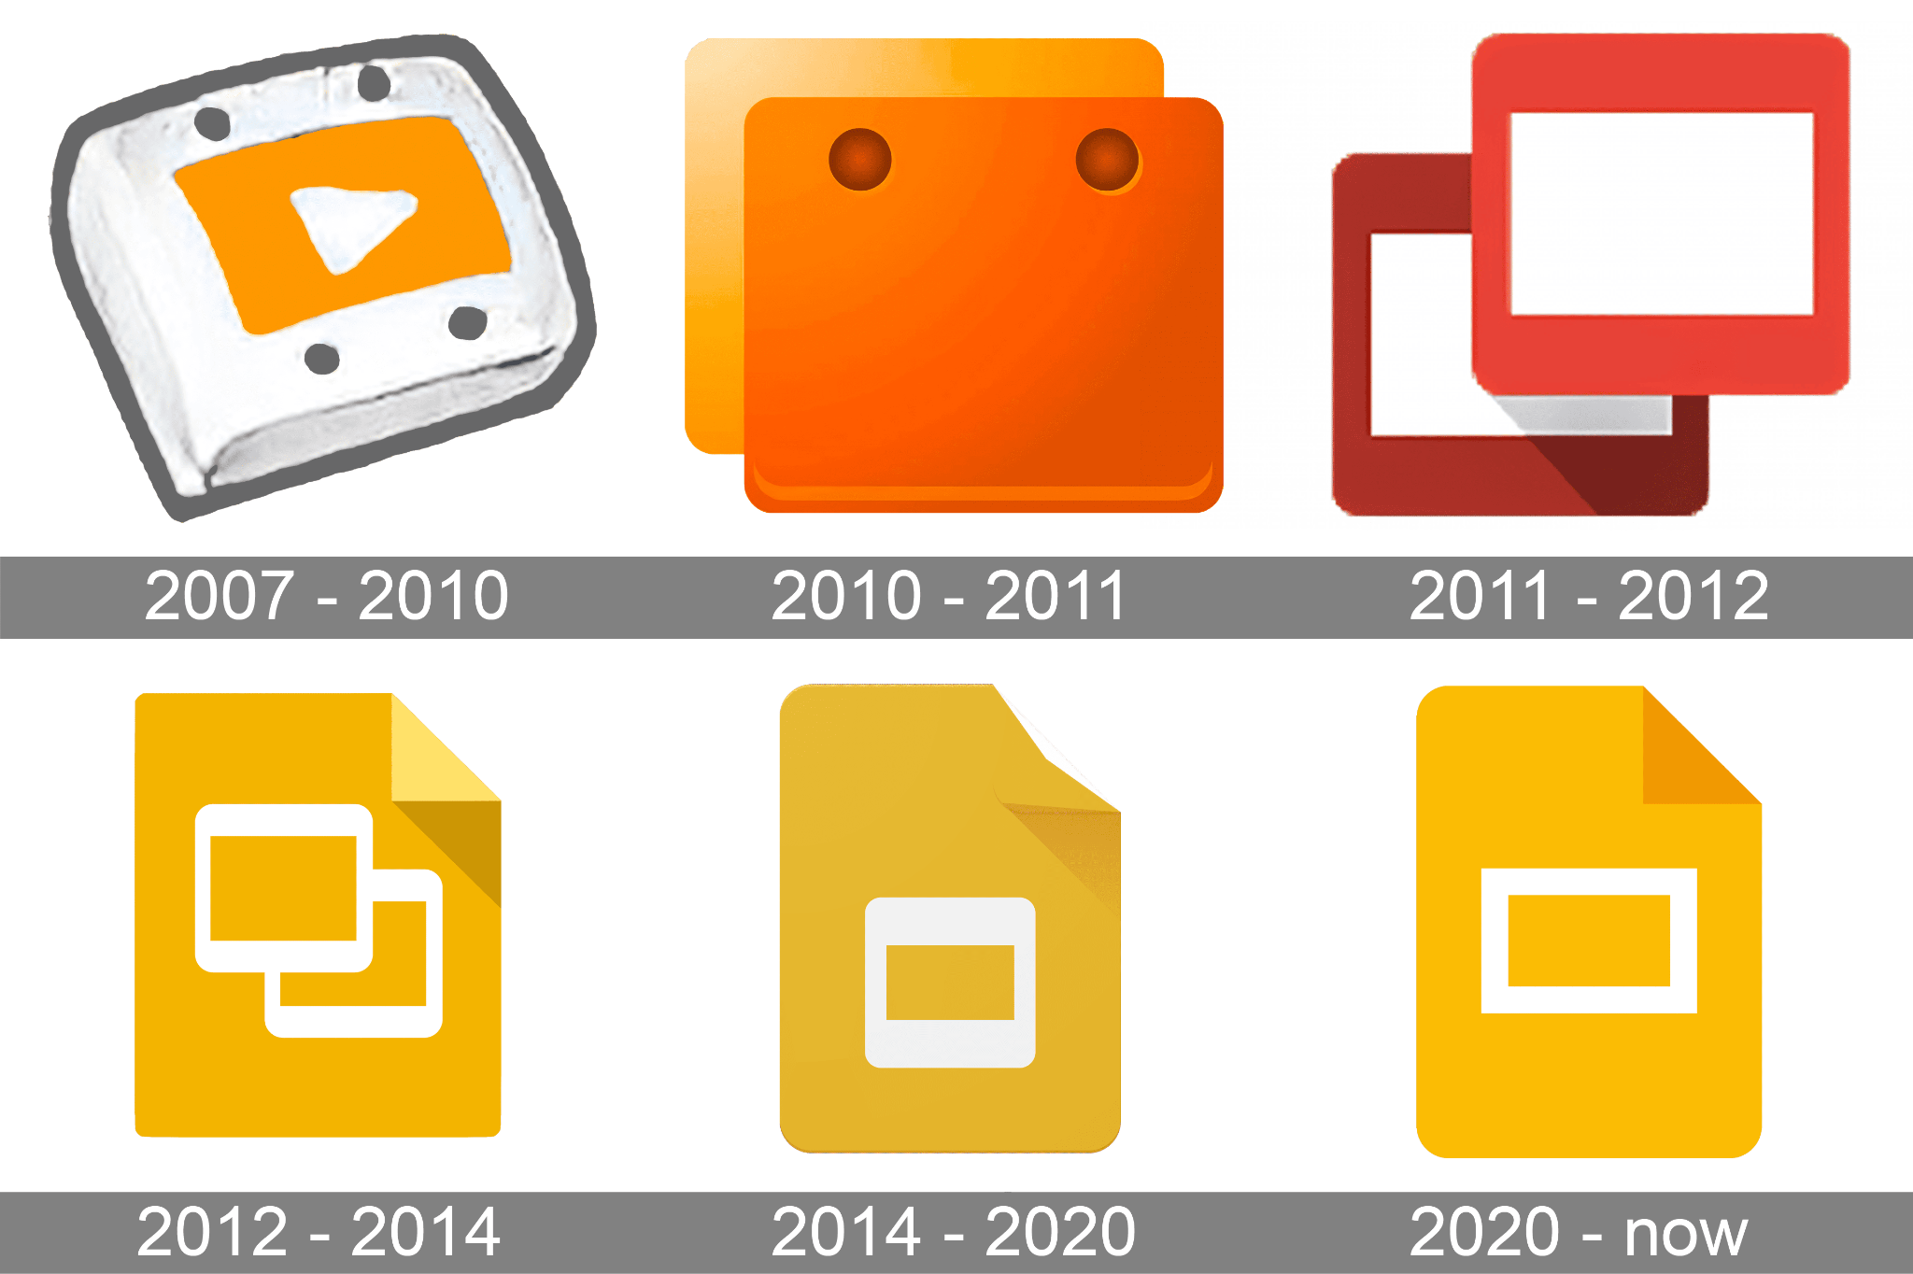
GOOGLE SLIDES
BRIEF LOGO HISTORY
an online presentation app that lets you create and format presentations and collaborate with other people

Slide 5


TIMELINE
1987
2007
2012
2013
April, May
September
October
August
Microsoft Powerpoint (PPT) for Macintosh & Windows
Google Presentations
Renamed to Google Slides
Canva

Slide 7
QUESTION # 1
When was Google Slides renamed?

Slide 8
FUNCTIONS AND APPLICATIONS

Slide 9
FUNCTIONS
Presentation Creation
Used to create, edit, and organize slides containing text, images, charts, videos, and other media.

Slide 10
FUNCTIONS
Visual Communication
Helps present information clearly using layouts, designs, animations, transitions, and visual aids.

Slide 11
FUNCTIONS
Collaboration
Allows multiple users to work on the same presentation at the same time, making group work easier.

Slide 12
FUNCTIONS
Information Sharing
Helps communicate ideas, facts, and important information to an audience in an organized format.

Slide 14
QUESTION # 2
What are the functions of Google Slides?

Slide 15
APPLICATION
Education
Creating lectures, classroom presentation, interactive learning materials, student reports, group projects, and visual study guides.

Slide 16
APPLICATION
Event Presentations
Organizers can use Google Slides for programs, schedules, announcements, or visual presentations during events.

Slide 17
APPLICATION
Community Development
Presenting community needs assessments, disaster-preparedness plans, development projects, and public- awareness campaigns.

Slide 18
QUESTION # 3
An organizer needs to display event schedules, live announcements, and program flows on screens during a conference. Which specific category of Google Slides applications does this scenario describe?
Event Presentation
Community Development
Education

Slide 20
APPLICATION
Trainings and Seminars
Teachers or organizations can use presentations to teach employees or participants about procedures, skills, or new information.

Slide 21
APPLICATION
Business Use
Business proposals, sales presentations, marketing plans, project updates, financial reports and company meetings

Slide 23
QUESTION # 4
In Trainings and Seminars, what are the three main things teachers or organizations teach using Google Slides?
Layouts, designs, and visual aids
Procedures, skills, or new information
Programs, schedules, and announcements

Slide 24
STEP BY STEP DEMONSTRATION

Slide 25
1. Open Google Slides
Open your web browser.
Go to Google Slides.
Sign in using your Google account.
Click Blank presentation.

Slide 26
2. Name the Presentation
Click Untitled presentation at the upper-left corner.
Enter your desired file name.
Press Enter.

Slide 27
3. Choose a Theme
Click Theme in the toolbar.
Choose a theme from the available options.
The theme will automatically be applied to your slides.

Slide 28
4. Add and Edit Text
Click inside a text box.
Type your title or content.
Highlight the text to edit its appearance.
Use the toolbar to change the:
  Font size
  Font style
  Text color
  Alignment

Slide 29
5. Add a New Slide
Click the + button.
A new slide will appear.
Click the dropdown arrow beside the + button to select a specific layout.
Choose a layout such as Title and Body, Two Columns, or Blank.

Slide 30
6. Insert an Image
Click Insert.
Select Image.
Choose where to get the image:
Select the image.
Click Insert.
Resize and reposition the image as needed.
  Select the image.
  Click Insert.
  Resize and reposition the image as needed.

Slide 31
7. Insert a Video
Click Insert.
Select Video.
Search for a YouTube video or paste a video URL.
Select the video.
Click Insert.
Resize and position the video.

Slide 32
8. Add Shapes
Click the Shape icon in the toolbar.
Select a shape.
Click and drag on the slide to create it.
Add text inside the shape if needed.
Customize the fill and border.

Slide 33
9. Add Transitions
Select the slide.
Click Slide.
Select Transition.
Choose a transition effect.
Adjust the speed if needed.
Click Apply to all slides if you want the same transition for the entire presentation.

Slide 34
10. Add Animations
Select an object, such as text or an image.
Click Insert.
Select Animation.
Choose an animation effect.
Select when the animation should start.
Adjust the speed if necessary.

Slide 35
11. Share the Presentation
Click Share at the upper-right corner.
Enter the email address of the person you want to share it with.
Choose their permission:
  Viewer – can only view
  Commenter – can view and comment
  Editor – can edit
Click Send.

Slide 36
12. Present the Slides
Click Slideshow at the upper-right corner.
The presentation will open in presentation mode.
Use the arrow keys or click to move between slides.
Press Esc to exit the slideshow.

Slide 37
13. Collaborate in Real Time
Share the presentation with your classmates or group members.
Give them Editor access.
Multiple people can work on the same presentation.
Changes are automatically saved.

Slide 38
QUIZ
TIME

Slide 39
THANK
YOU!

